Slide 1
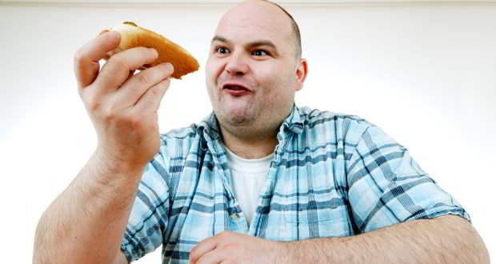
Smart Food
Tanya Kamesh, Joe Cannarozzo, Ben Sterling, Sara Huang

Slide 2
Facts and Figures
In 2013 30-40% of US food supply: WASTED
In 2008 $390 per U.S. consumer: WASTED
WASTED food is “the single largest type of waste entering our landfills”– Bob Perciasepe, EPA Acting Administrator

Slide 3
Customer Segment
The customer segment that we’ve targeted are:
Middle to lower class ($30,000-$65,000 annual salary) families
More than two members, with 2 working members
Homeowners
Inclined to purchase the latest technology.

Slide 4
Sample Interview Answers
1. How much food do you waste (percentage wise)?
-”Umm percentage wise id probably say like 15% 20% or so.”
-”Umm maybe about a quarter I’d say. I don’t live here I live in California so I’ve got famliy, so yeah.”
-”Umm maybe like 10-15%”
-”Say maybe 5-10%; I eat a lot”

Slide 5
Sample Interview Answers
2. Is it harder to buy higher quality food because it goes bad faster?
-”I would say sometimes especially like with the organic stuff, it can just go bad too quickly so if I’m paying a higher price for it, it doesn’t even make sense unless I can buy an individual apple or something.”
-”Yes, I think so; It is a problem.”
-”Yeah definitely”

Slide 6
Sample Interview Answers
3. Do you use an item or app to aid in organizing your day?
-Uses an organizer app and book for general schedule keeping
- No, he just writes things down as he goes, or he remembers it as best as he can

Slide 7
Sample Interview Answers
4. What is your opinion on the quality and functions of technology today?
Loves the older technology, feels the new forms of technology are too complicated to use, but understands that they help with everyday functions better then the older versions
He likes it, wishes he could afford the newer stuff, but using it is just great, adds a lot of better things to the world today even though it is “taking over our lives”

Slide 8

Works Cited
http://www.usda.gov/wps/portal/usda/usdahome?contentidonly=true&contentid=2013/06/0112.xml

